Slide 1
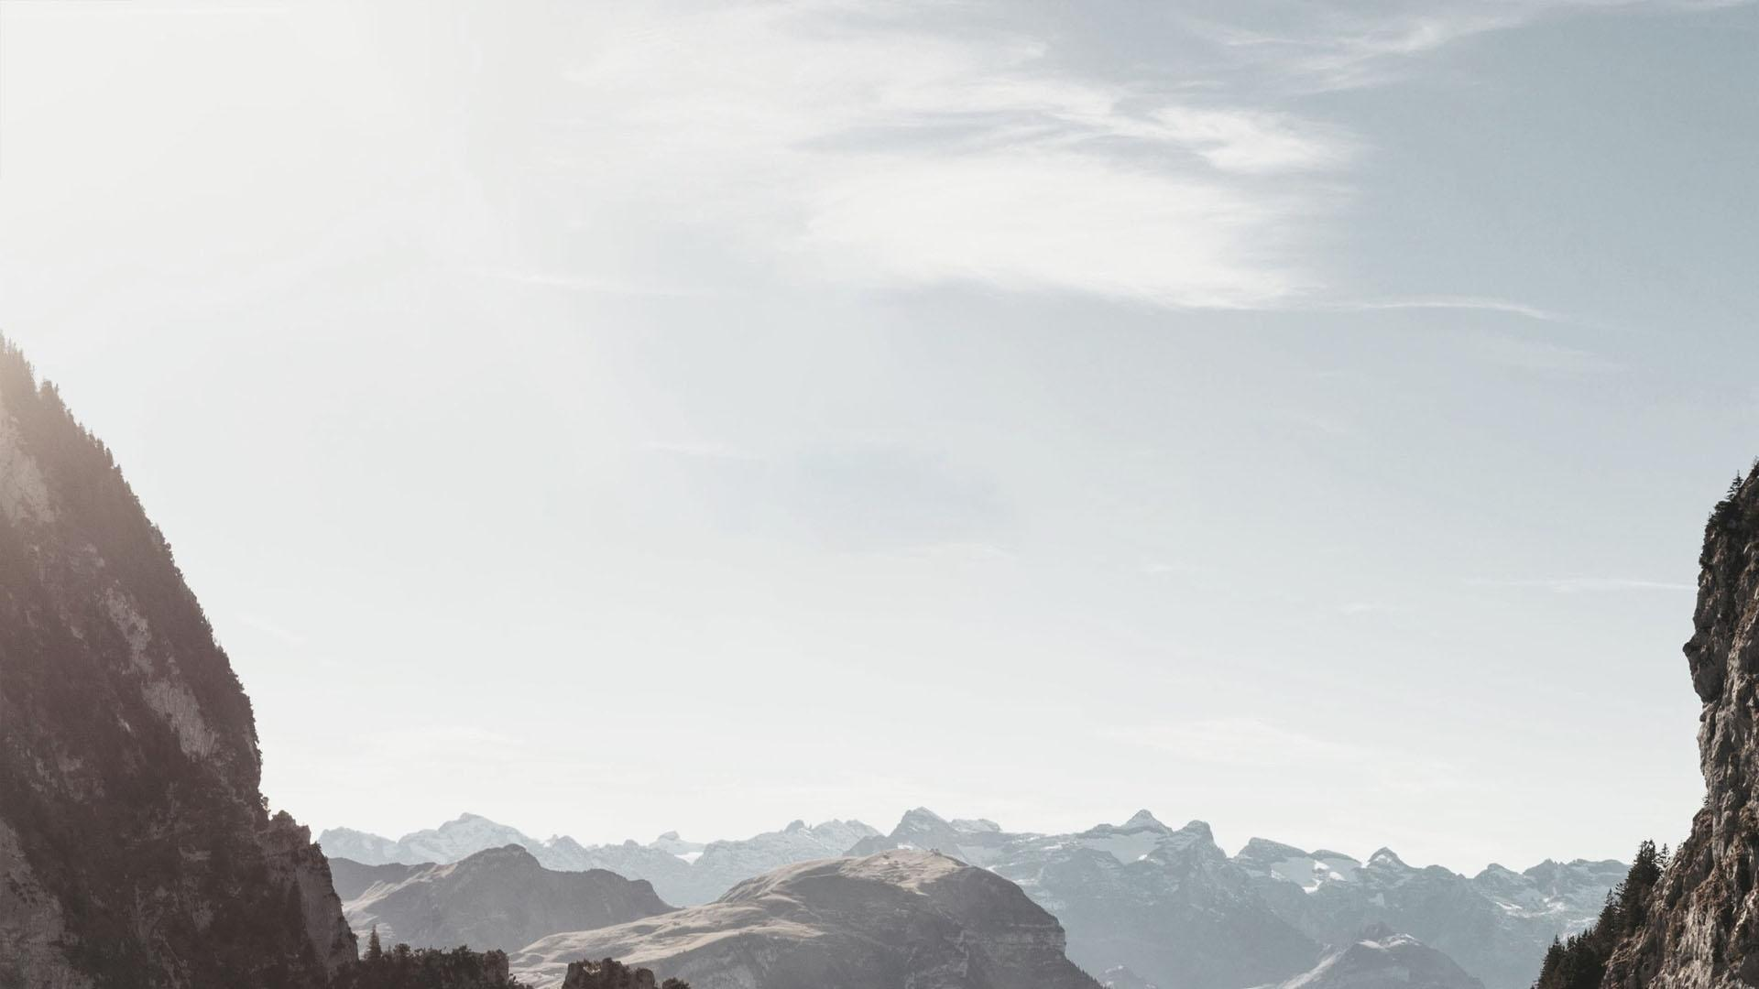
Progress Presentation
Automatically identifying Adult Peregrine Falcon In Camera-trap Images
Reported by Team 6

Slide 2
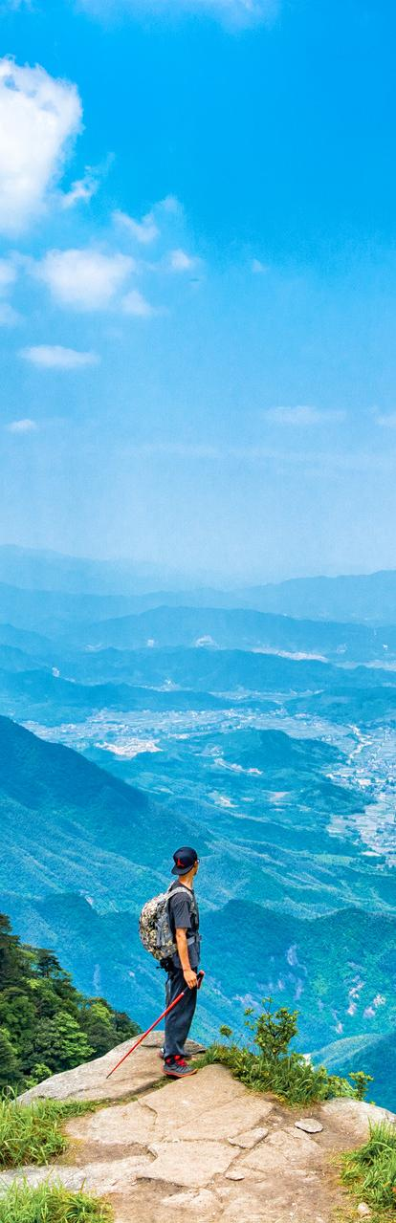
PART 01
PART 02
Brief introduction of what we did
The problem we met (non-trivial）
PART 03
PART 04
The approaches we used and comparison
What we learned

Slide 3
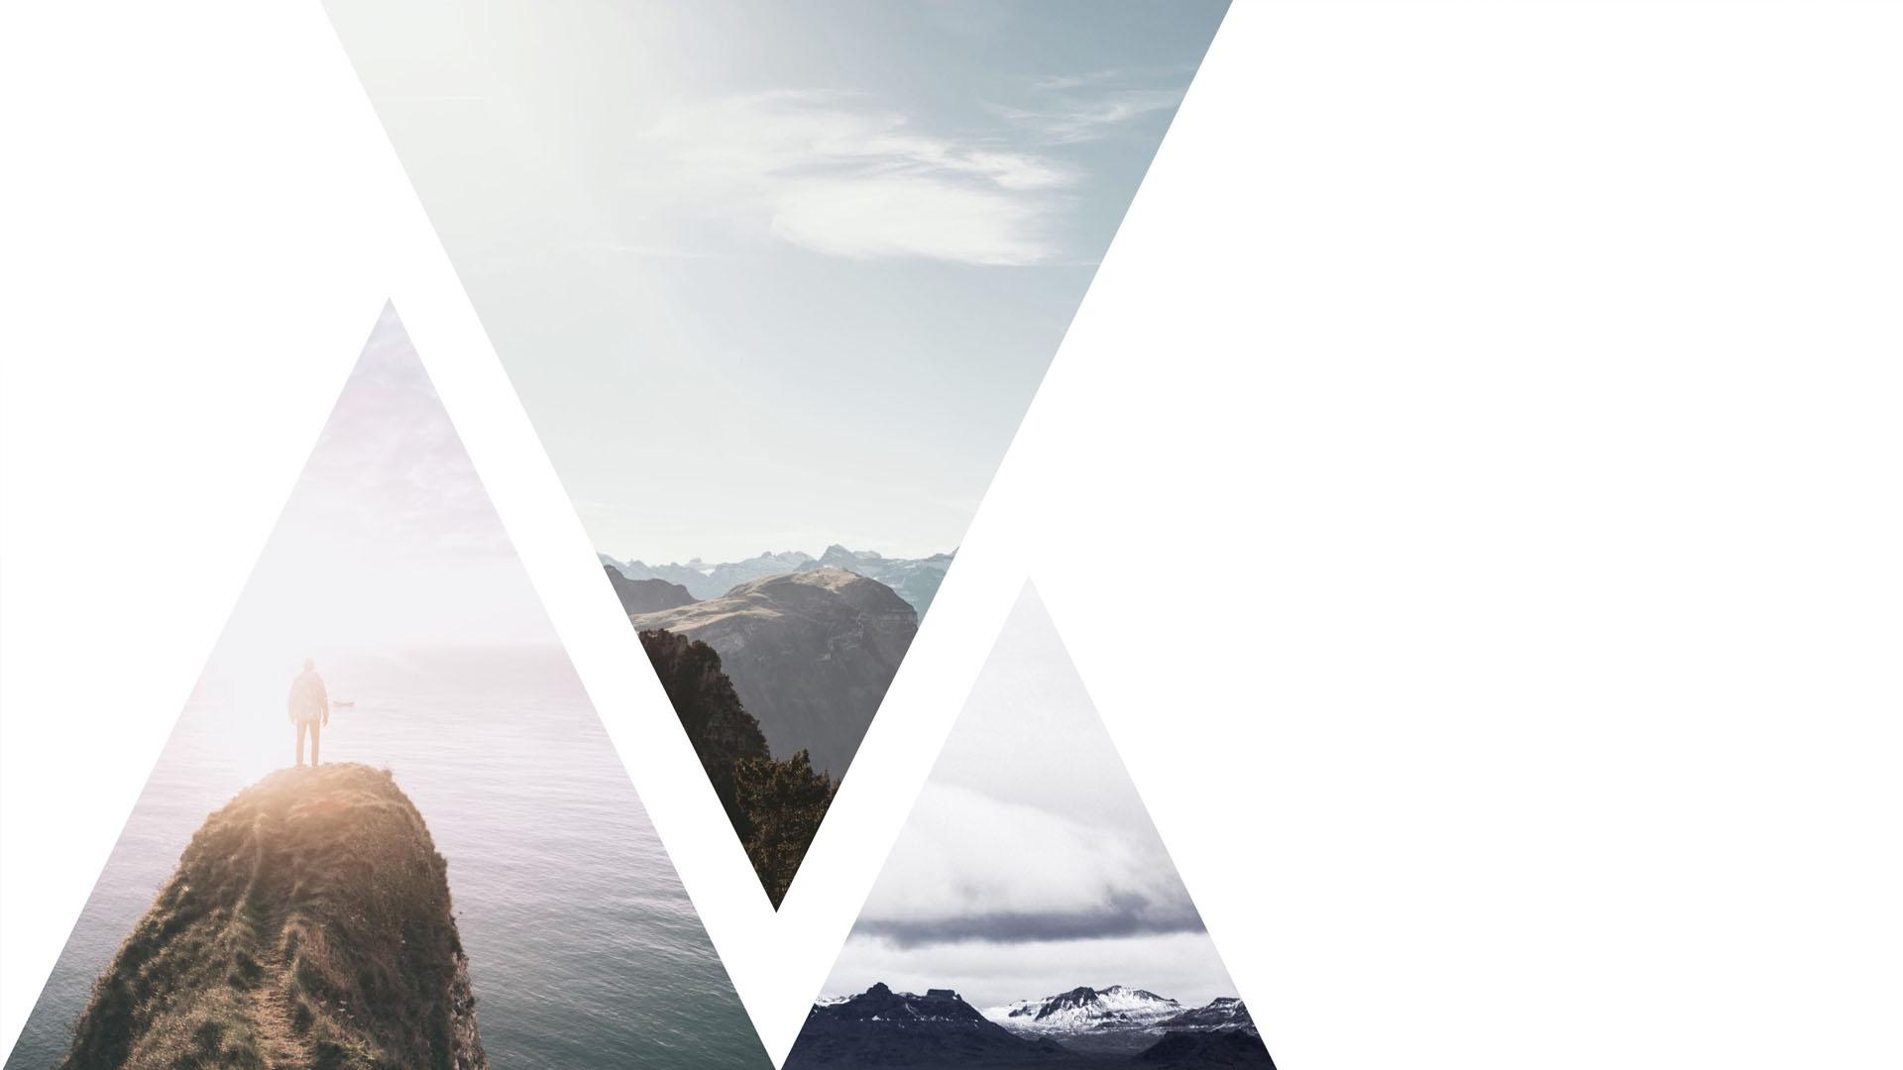
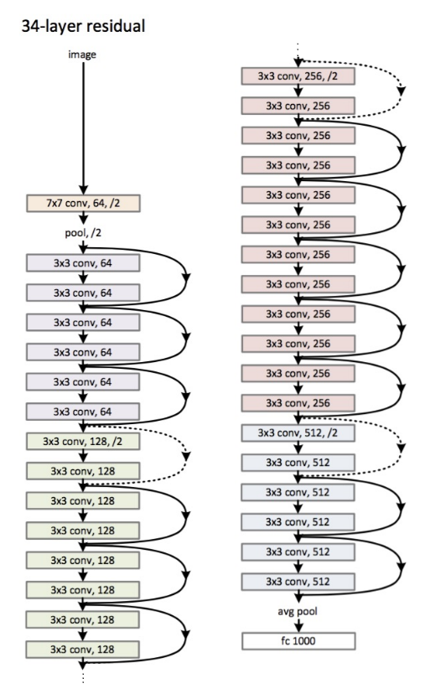
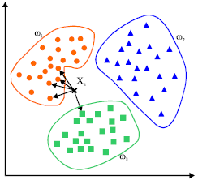
01
Summarization
We use Deep learning (CNN, Res-Net) and Machine Learning (SVM, KNN) to process the image.
Each method including its pros and cons

Slide 4
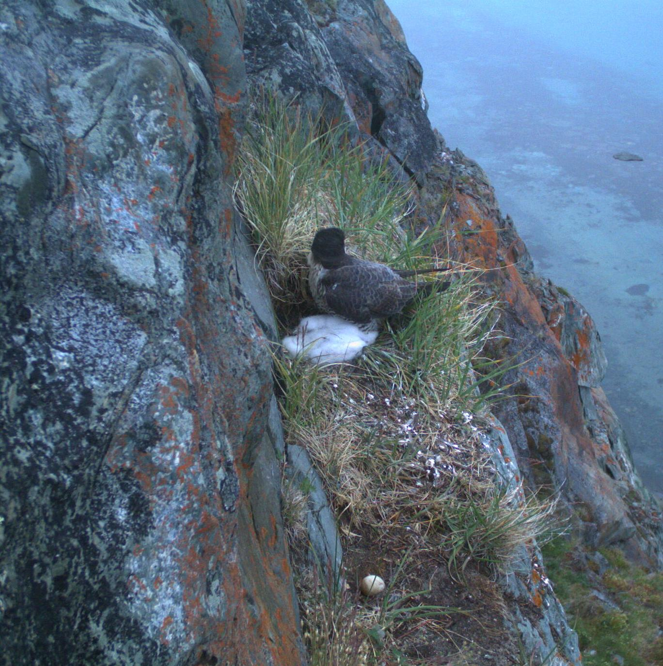
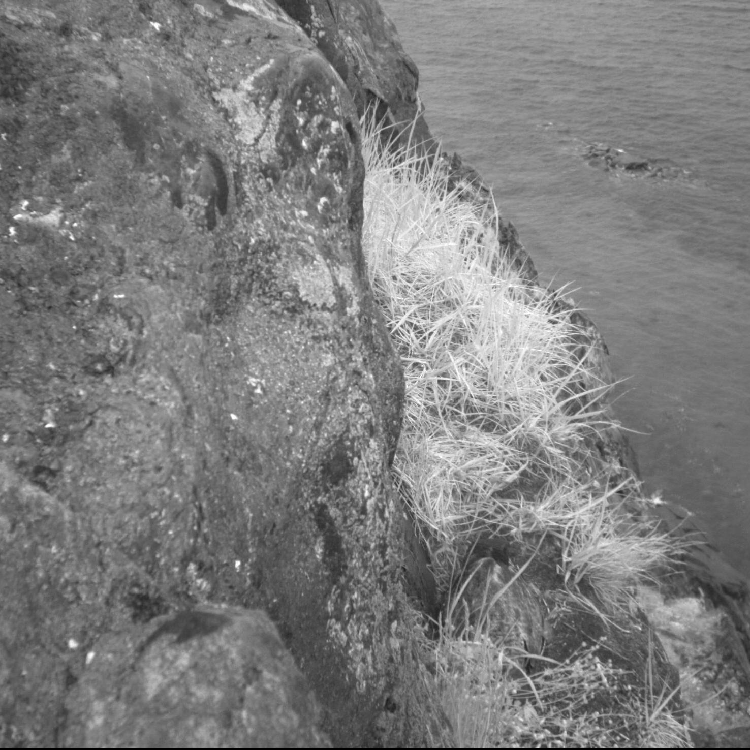
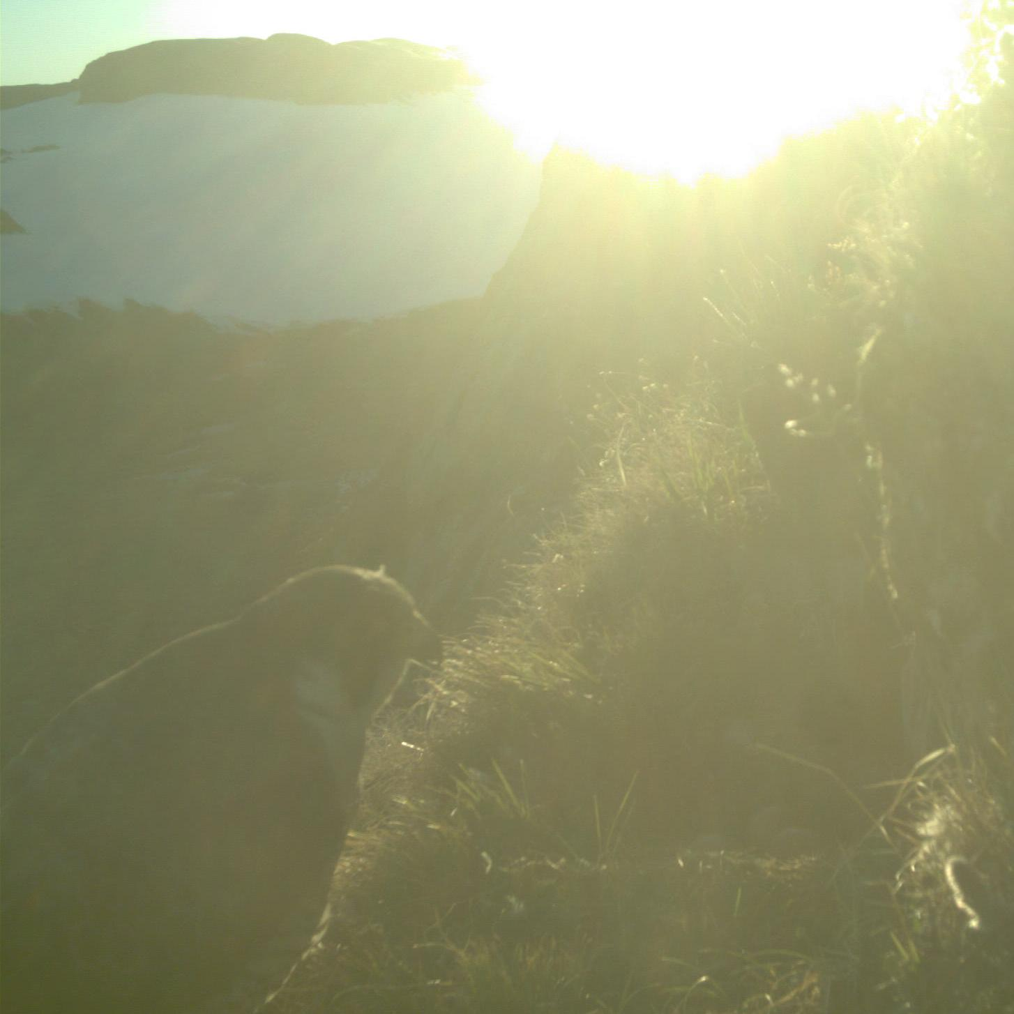
What problem is being addressed?
01
Input/output
Evaluation
Input: image
Output: 0/1
Accuracy of prediction
based on loss function

Slide 5
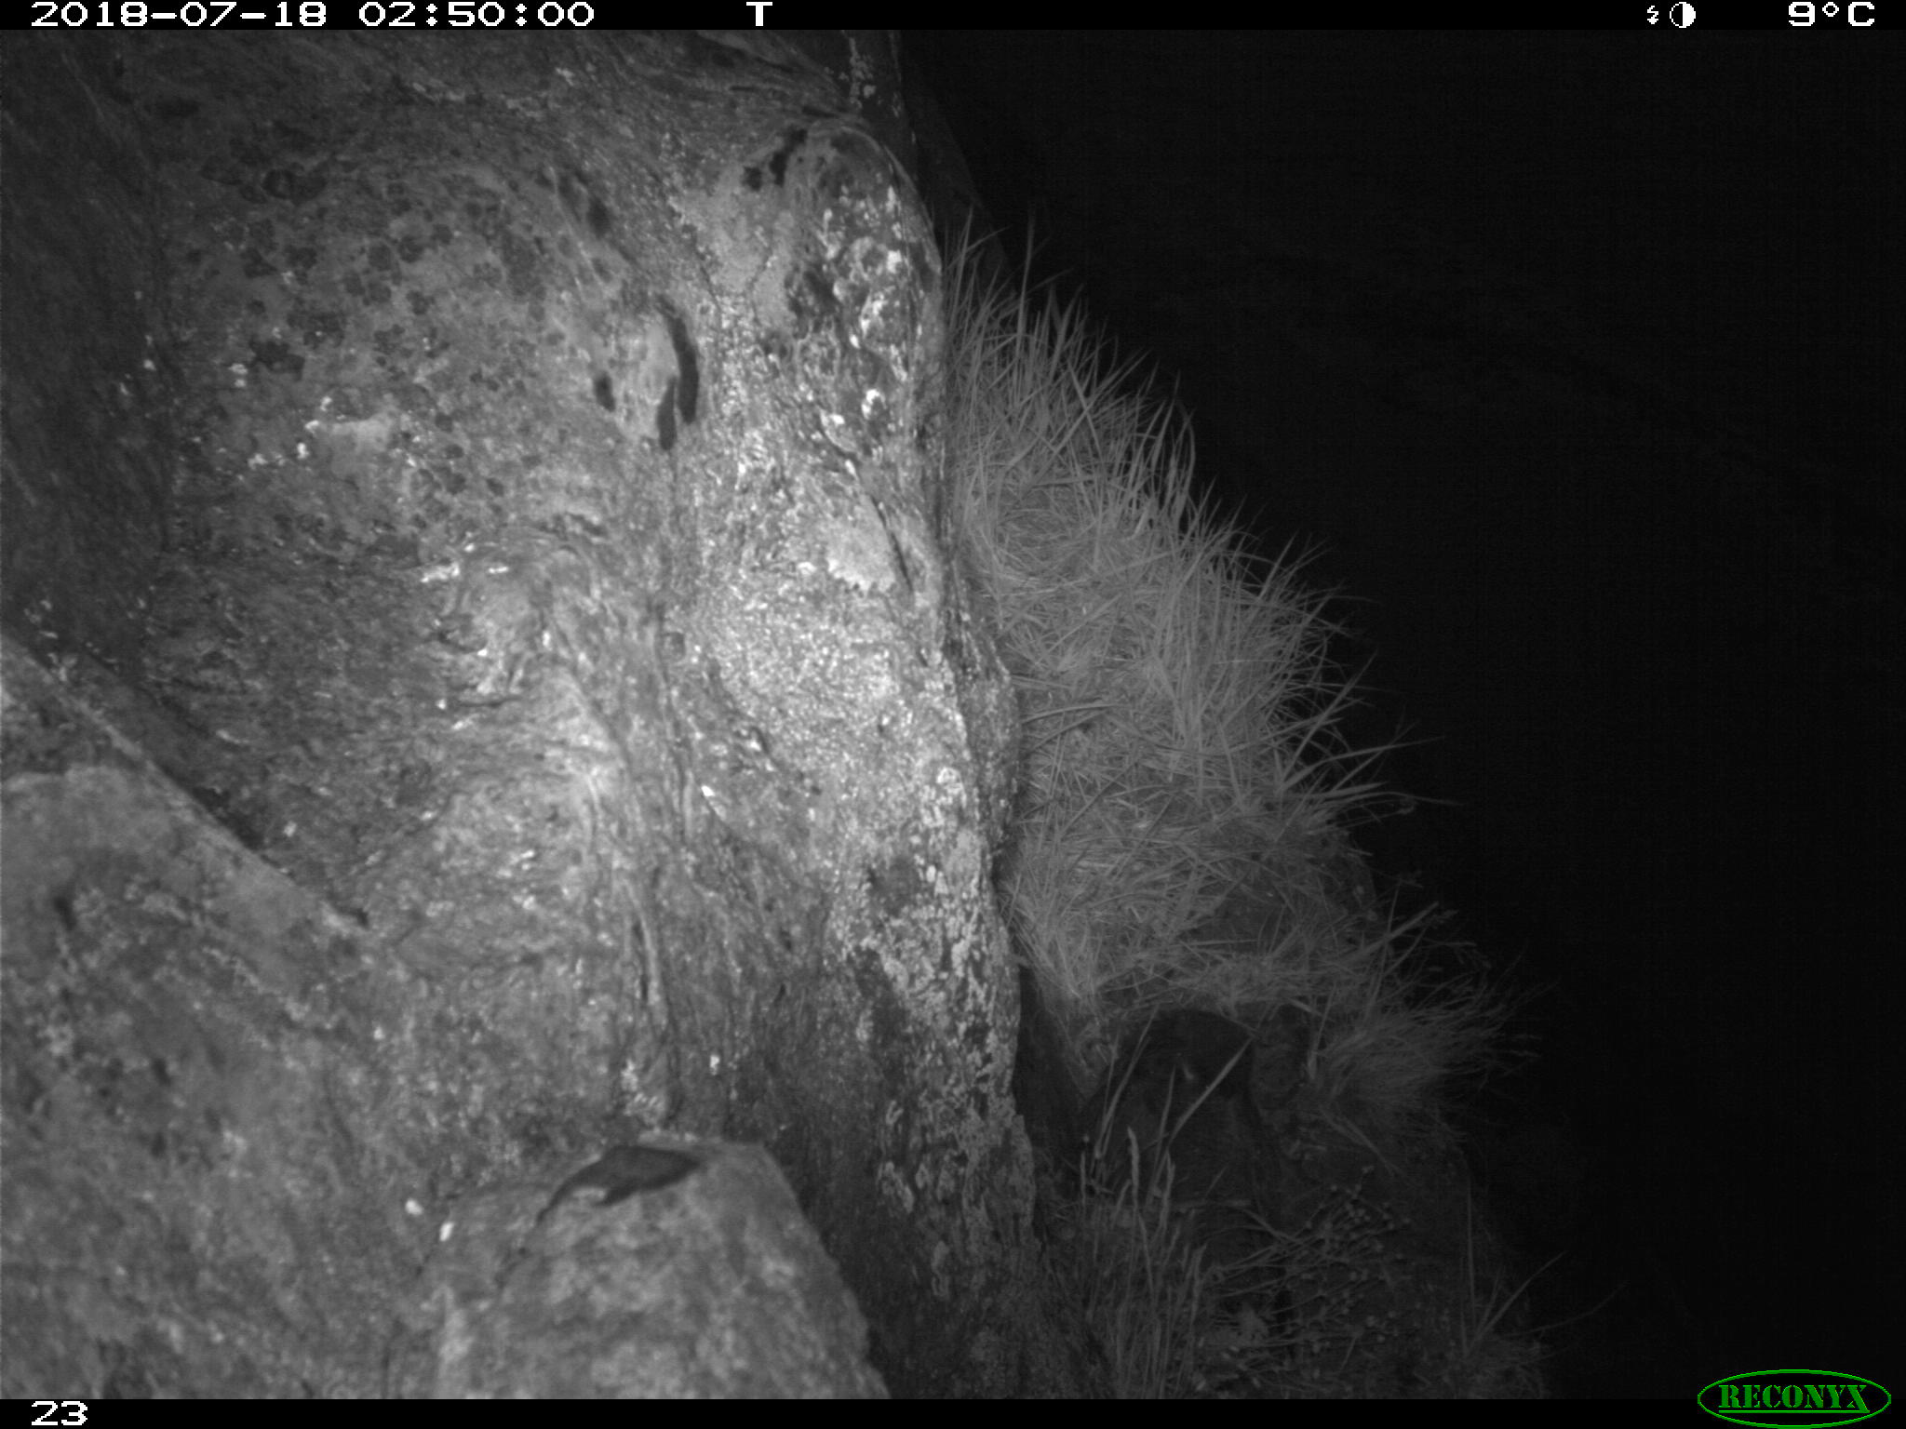
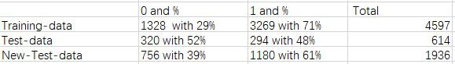
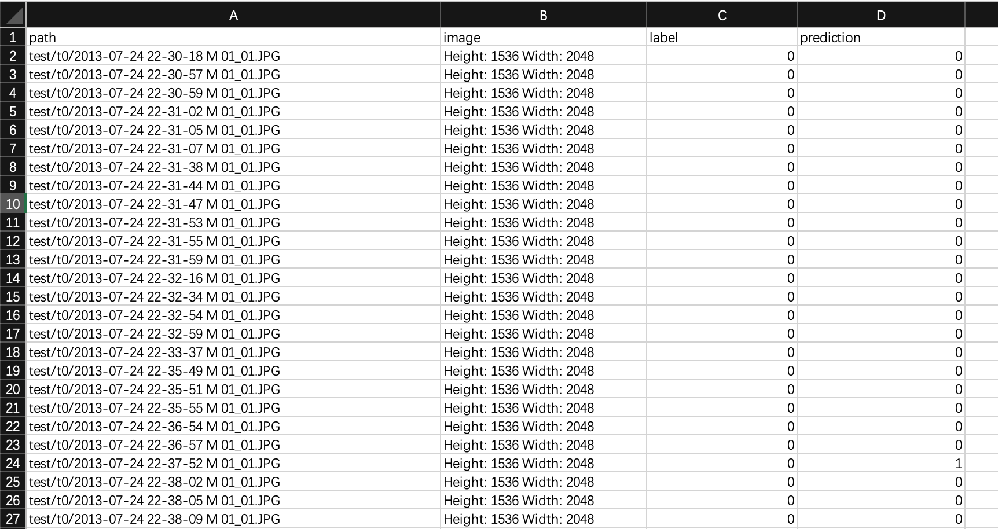
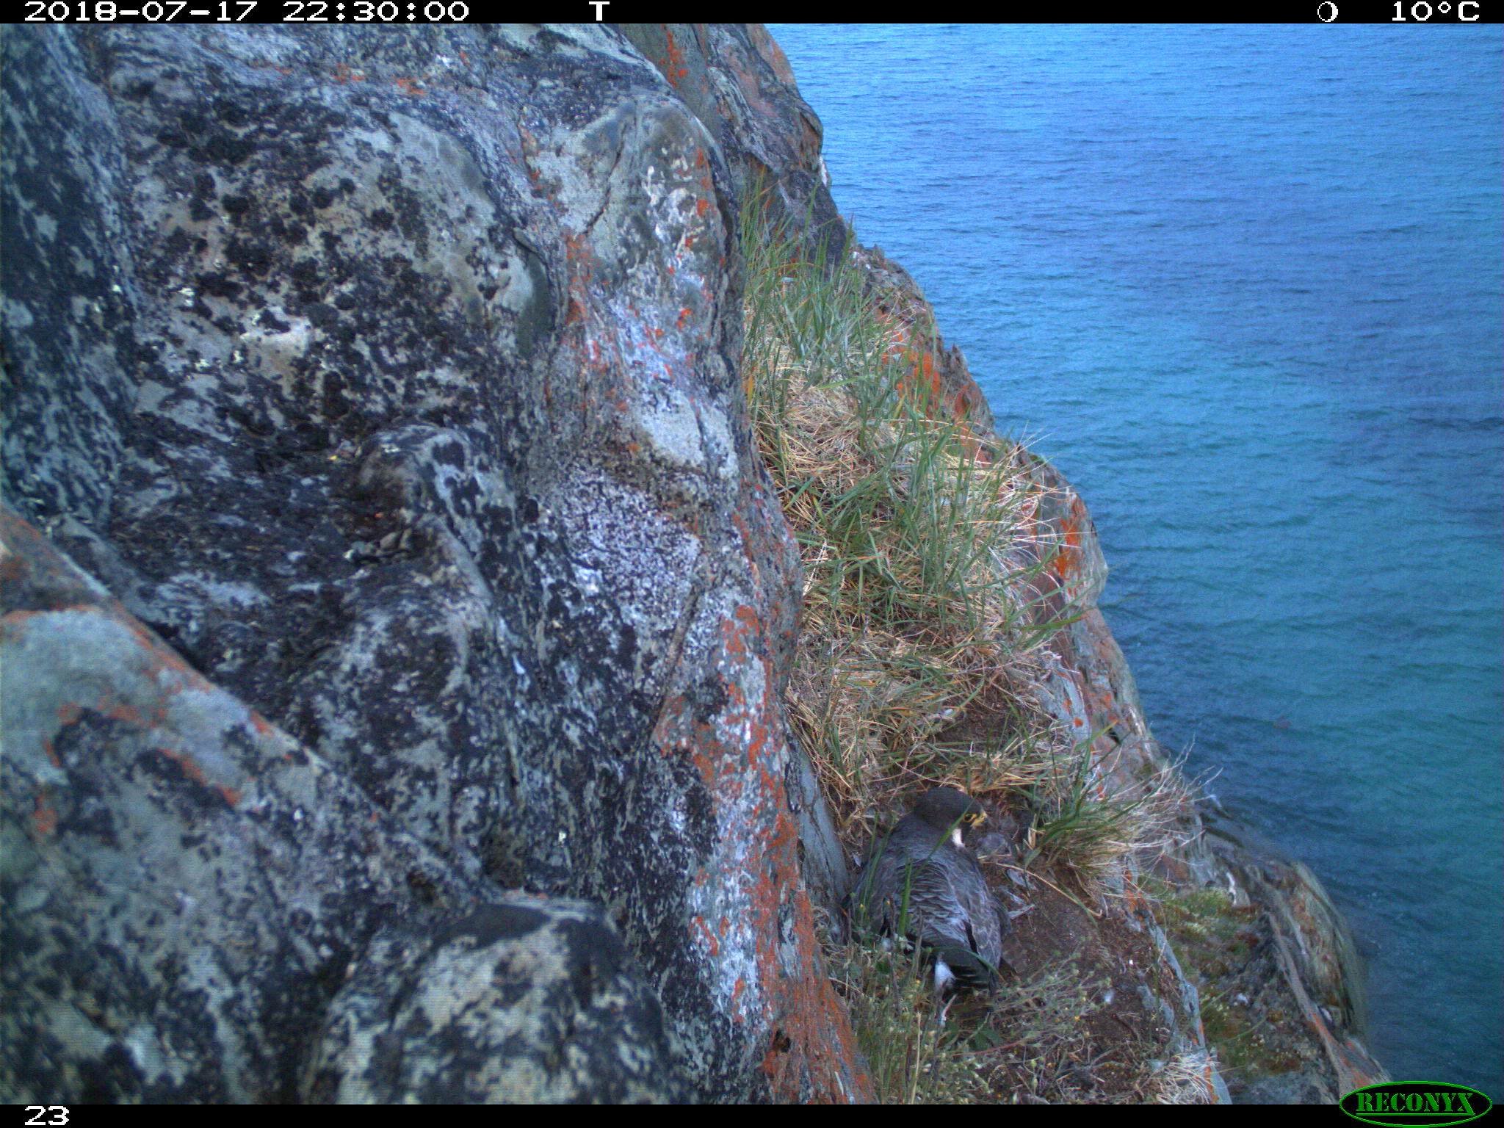
01
Baseline:
CSV File Including Name of the image and prediction (0/1)

Slide 6
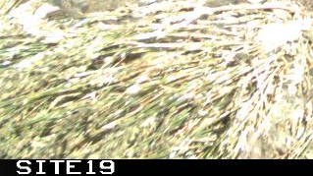
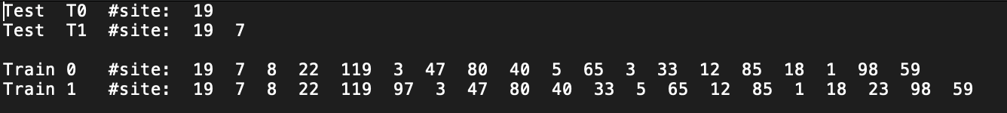
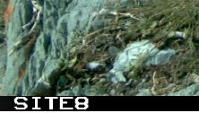
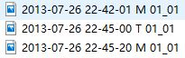
Problems
02
A. The limitation of Data set
Test-data : ~600 images only site 19 and 7.
Train-data: ~4000 images ~20 sites
B. Expect Problem
Day vs Night: The daytime images are total different with night-time images, and we also try to train image from daytime and test night time images, the result show in the report (extreme special cases)
3-movement images captured: those images will have special name M = move, we just need to delete 2 of them, then train and test.
Notes:
The problem we met. First, we only have 600 images in test data and all come from nest 19 and 7. As for training data, even we have 20 nests but comparing with over 100 nests in database , we still don’t have enough environments. Second, day and night image, since the daytime image are total different from the night time images, so we try to train image from daytime and test night time images, vice versa. Those are extreme special cases so it will show the result in our report. In our meeting, we talked about 3-movement images captured, if the camera detect the movement in front of camera, it will take 3 images, those 3 images are similar, we don’t need those duplicate image, when we train or test.

Slide 7
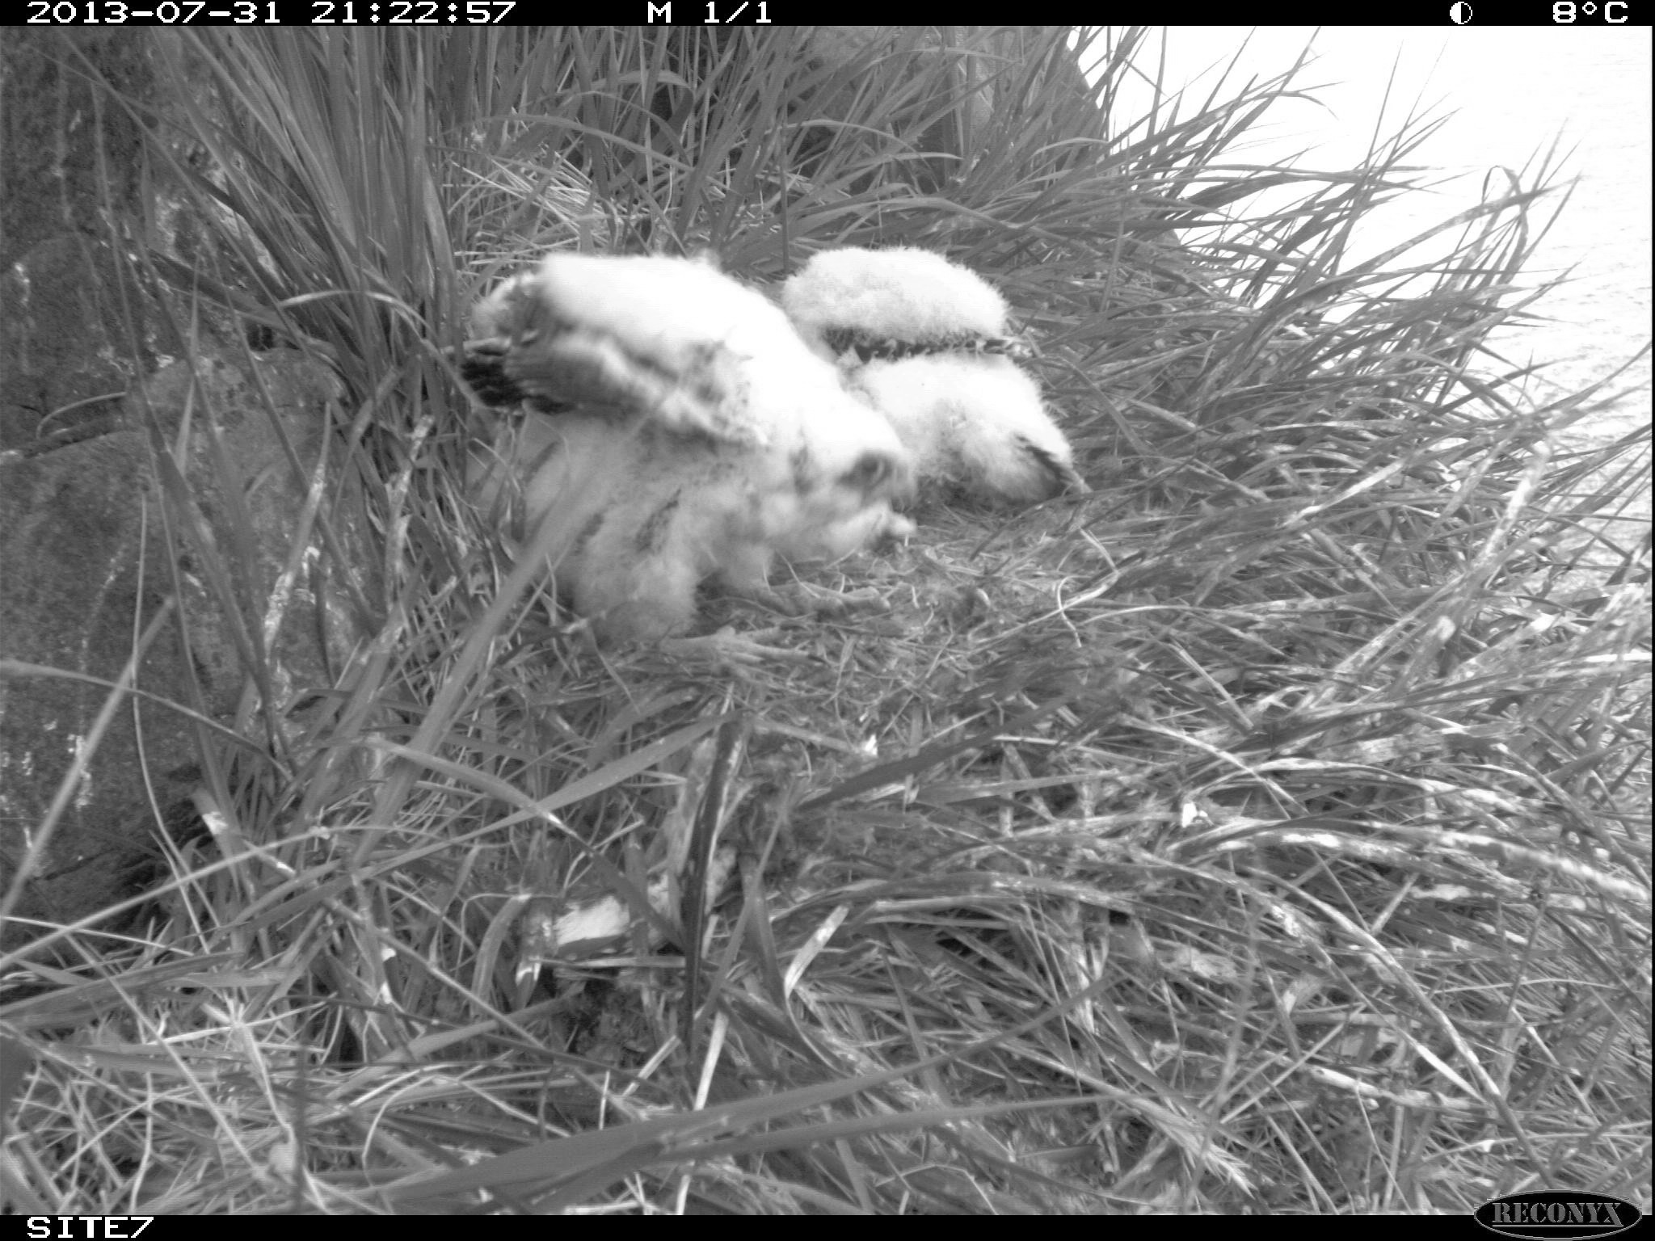
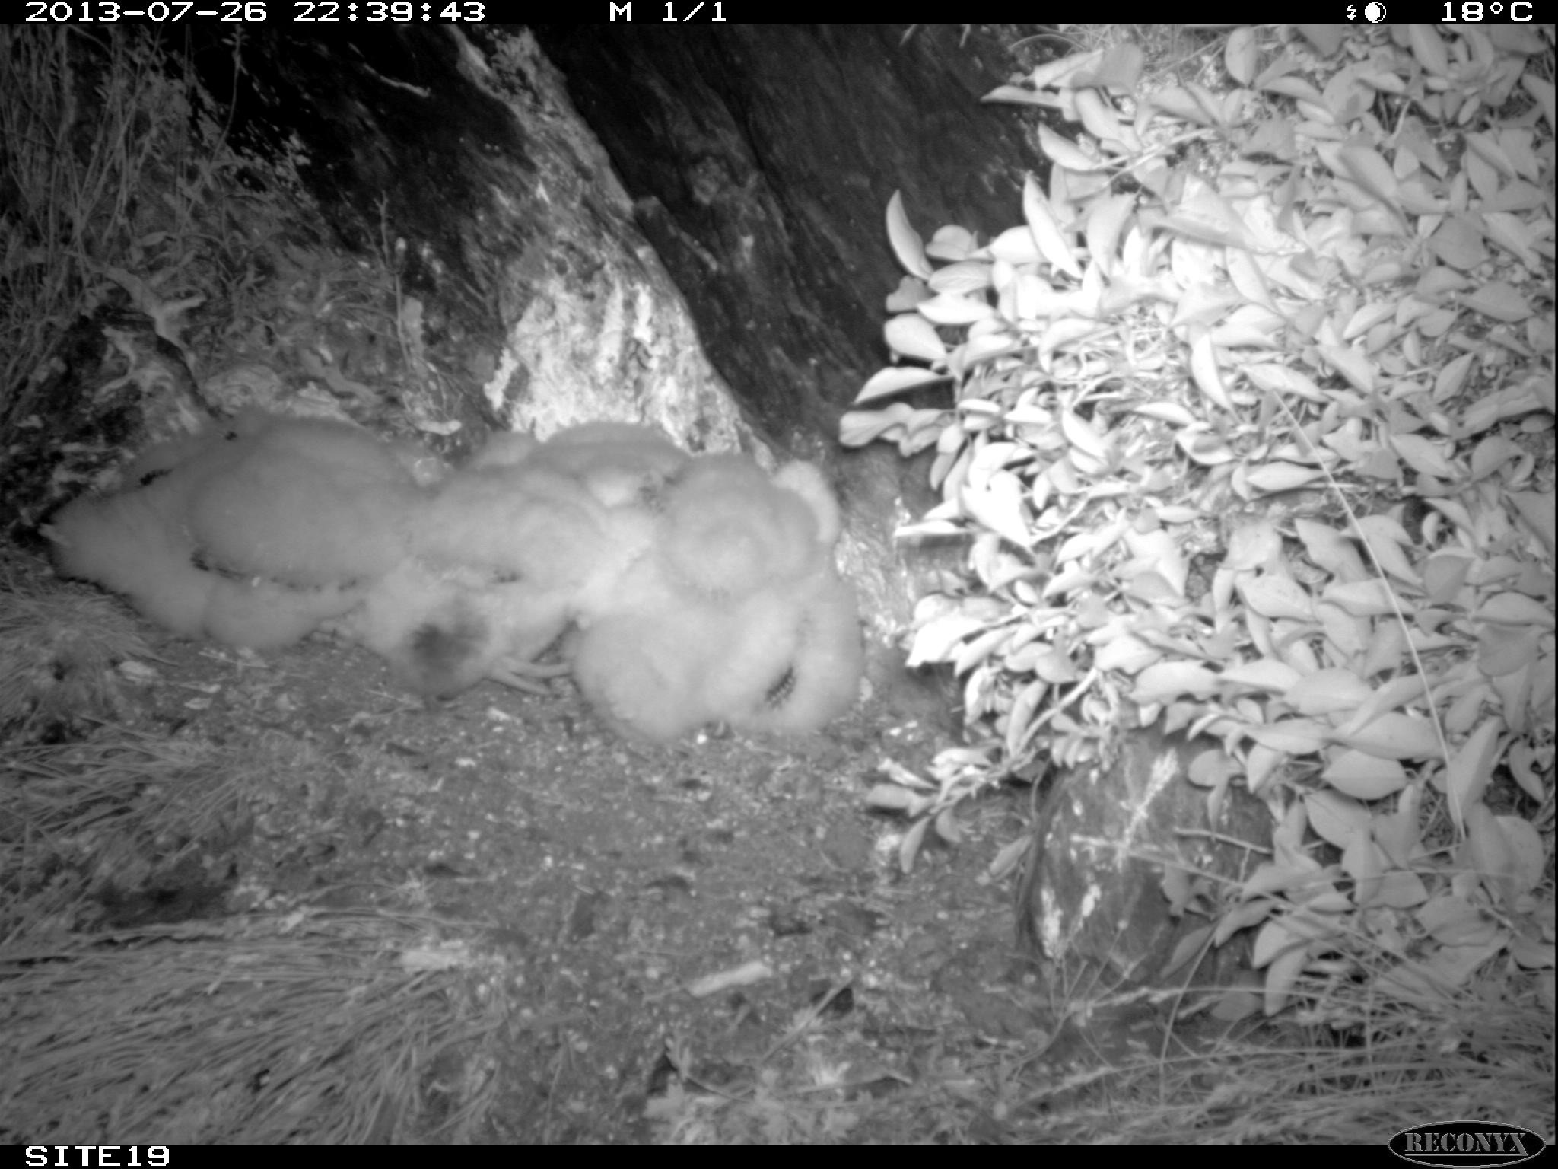
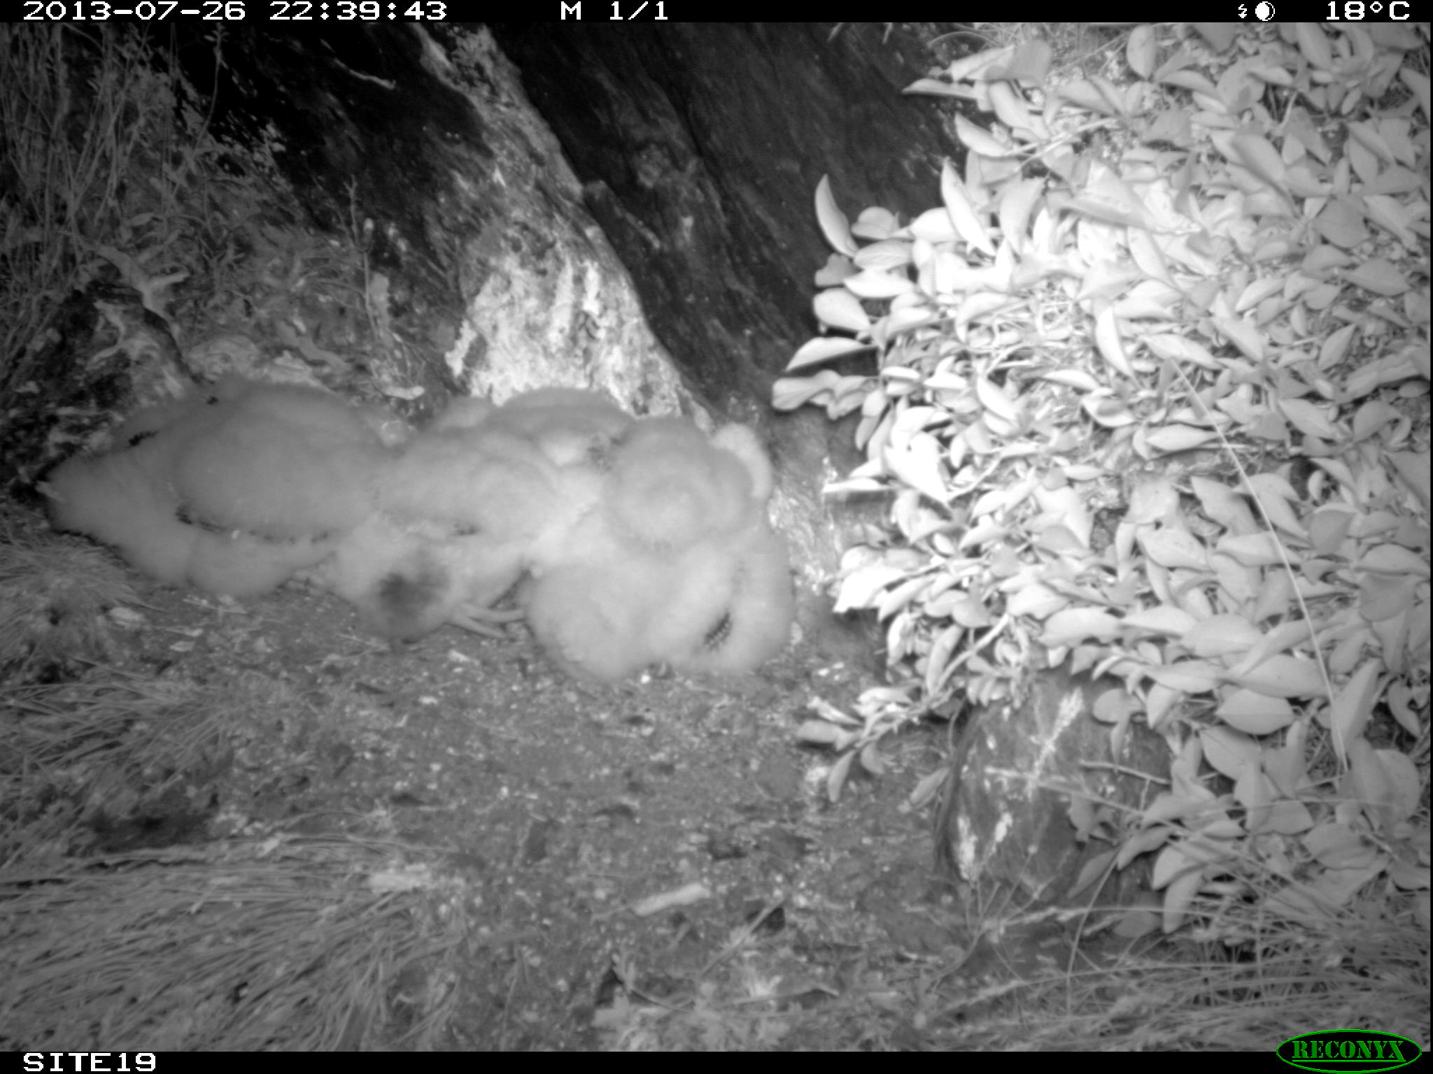
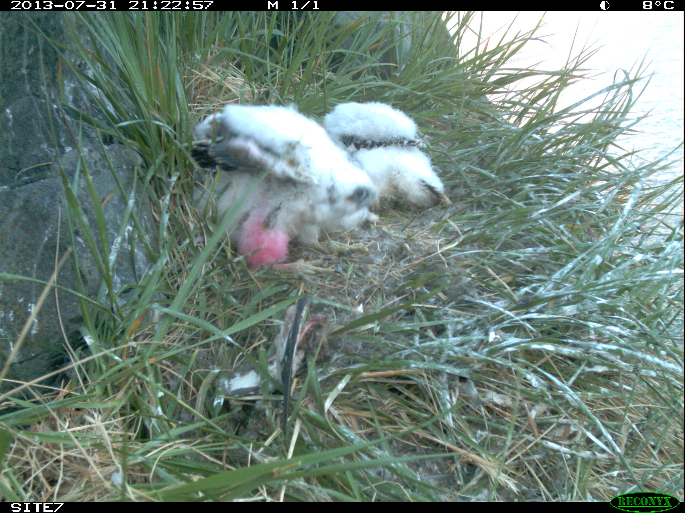
02
Image preprocessing
Since the original image size is 2048x1536, it is too large to be handled.
We down scale the size of them to 400x300.
Also, we tried grayscale images for traditional Machine Learning (KNN and SVM)
Notes:
We are also doing image preprocessing for machine learning methods, since original image size is around 2000x1500 , it is too large to be handled, our pc can not handle those images, so we down scale the size of them to 400x300 and grayscale images for those.

Slide 8
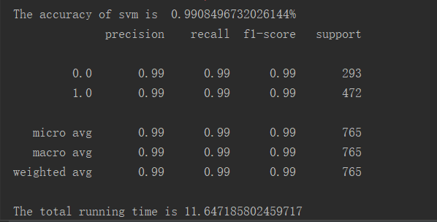
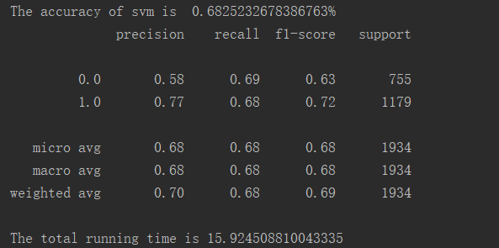
03
Method
SVM
We implemented a SVM as the classifier.
Use the linear kernel to check if the dataset is linear separable.
The New test-data Nests: new nests never train before
The test-data Nests: #19 and #7
99%
68%

Slide 9
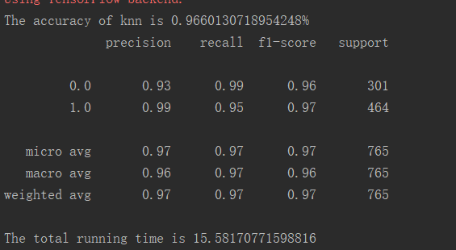
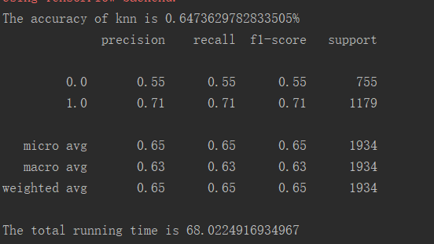
03
KNN
96%
The KNN algorithm can be used not only for classification but also for regression.
The key idea of ​​the KNN classification algorithm is that if the majority of the samples of the K most similar (ie, the nearest neighbors in the feature space) of a sample belong to a certain category, the sample also belongs to this category.
64%

Slide 10
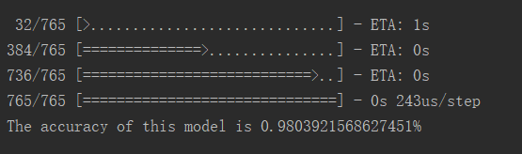
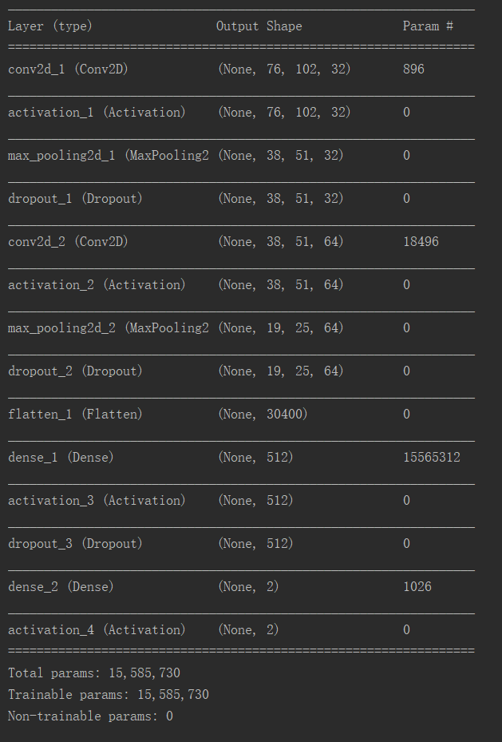
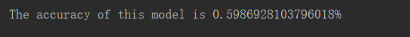
03
CNN
Structure
98%
With logistic regression as the classifier, the CNN contains two convolution layers, with =(3,3).
59%

Slide 11
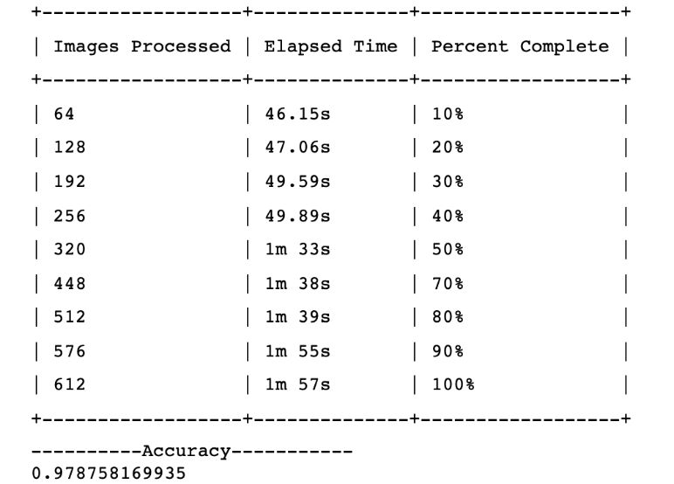
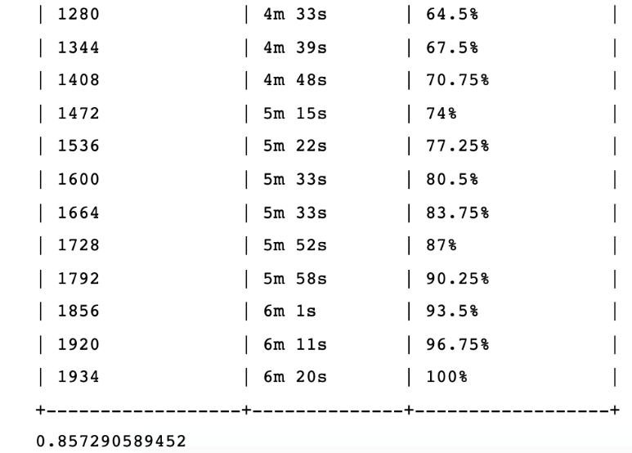
03
Res-Net 50
98%
86%

Slide 12
03
Deep Learning Approach
Traditional machine learning works ineffectively
while training and testing on different nests.
We also tried deep learning methods.
Namely, why did we prefer ResNet in this case?

Slide 13
04
Comparing to
Traditional Machine Learning
Image Classification
Problems
Capture raw pixel values to distinguish between different categories
Unsupervised
Classification module is trained with these images and labels
Feature Extraction cannot be tweaked according to images and labels
Insufficient training examples

Slide 14
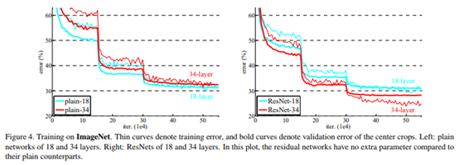
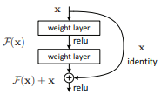
04
Comparing to other
Convolutional Neural Networks
Skip Connection
Advantages of ResNet
By increasing layer depth, vanishing gradient and degradation happens, thus training error increases.
Skip connection is introduced, learning from residual mapping rather than direct mapping
More layers improves accuracy
Less computational resources are needed

Slide 15
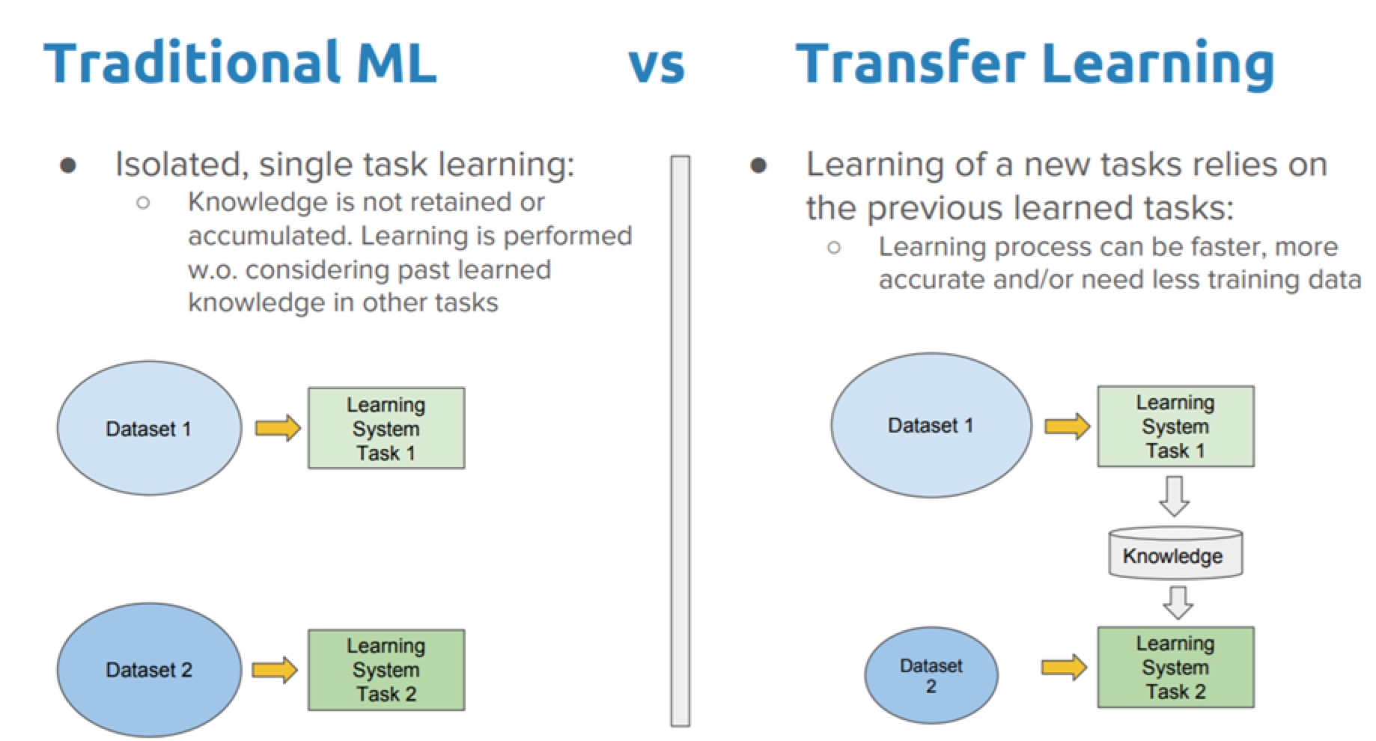
04
Transfer Learning
Stage 1: Create a CNN classifier on a large, general dataset. ImageNet, the models are already trained by researchers.
Stage 2: The outputs of each layer in the CNN can be viewed as a meaningful vector representation of each image. Extract these feature vectors from the layer prior to the output layer on each image of your task.
Stage 3: Create a new classifier with those features as input for our own task.

Slide 16
04
Q&A
Question?

Slide 17
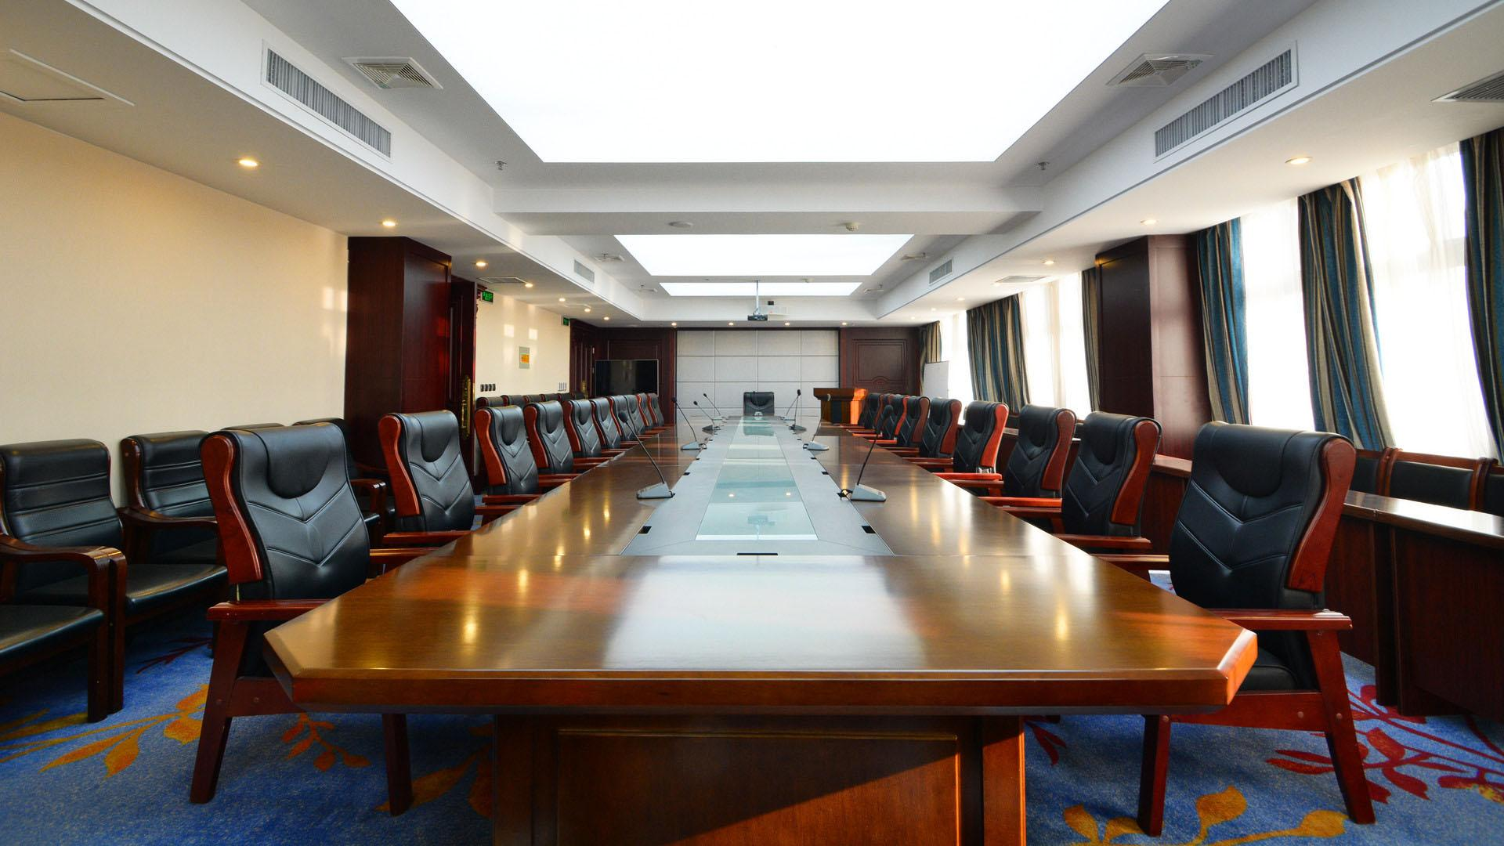
Thanks for watching
Reported by Team 6
Instructor: Russell Greiner
Co-coach: Erik Hedlin

